Slide 1
Online Retail Data Analysis Deep Dive & Dashboard Insights
By: Jinal Patel
ApexPlanet Internship

Slide 2
Objective
• Analyze sales and customer data • Identify key business trends • Perform deep-dive cohort analysis • Build interactive dashboard

Slide 3
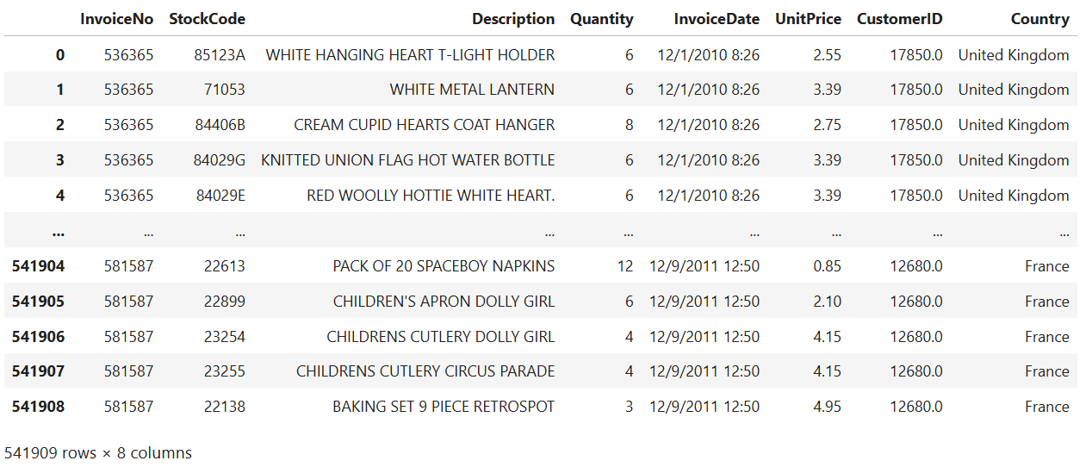
Dataset: Online Retail

Slide 4
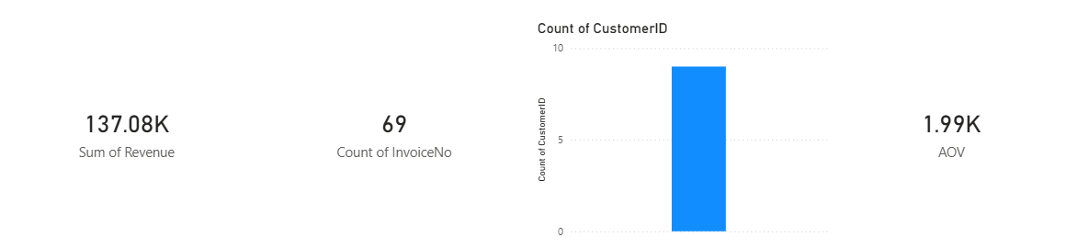
KPIs
Total Revenue: 137.08K
Total Orders: 69
Total Customers: 10
Average Order Value (AOV): 1.99K

Slide 5
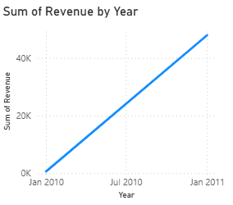
Revenue Trend
Revenue shows an increasing trend from Jan 2010 to Jan 2011 (line chart).
Observation: Growth is steady, indicating consistent sales increase over the year.

Slide 6
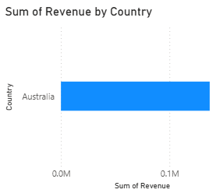
Country Analysis
Australia contributes the highest revenue (bar chart).
Other countries have negligible contributions in this dataset.

Slide 7
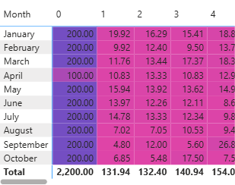
Cohort Analysis
Customer retention decreases over time (heatmap).
Highest revenue/retention observed in January cohort.
Later months show lower engagement and revenue per customer.

Slide 8
Insights
• Revenue increasing trend
• High contribution from UK
• Drop in retention after first month

Slide 9
Recommendations
• Improve retention strategies
• Focus on repeat customers
• Target high-performing regions

Slide 10
Conclusion
Data analytics helps drive business decisions and improve performance. Analyzing the Online Retail dataset shows how data analytics drives smarter business decisions and improves performance. By turning raw sales and customer data into a clear narrative, we identified top products, seasonal trends, and valuable customer segments, enabling targeted actions like personalized promotions and optimized inventory. Hypothesis testing validated key insights such as the impact of marketing campaigns on conversions—adding statistical confidence to our recommendations. Combining data storytelling with statistical validation ensures decisions are both actionable and evidence-based, helping the business grow efficiently and strategically.

